Slide 1
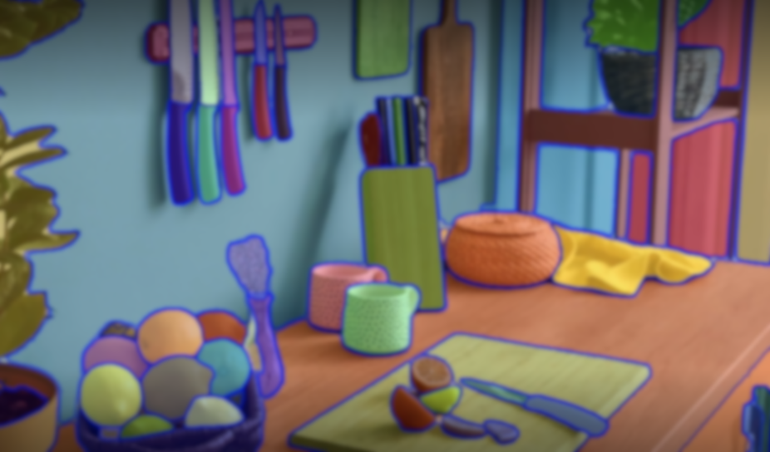

SAM 2: Segment Anything in Images and Videos
Ravi, Nikhila, Valentin Gabeur, Yuan-Ting Hu, Ronghang Hu, Chaitanya Ryali, Tengyu Ma, Haitham Khedr et al. "Sam 2: Segment anything in images and videos." (2024).

Slide 2
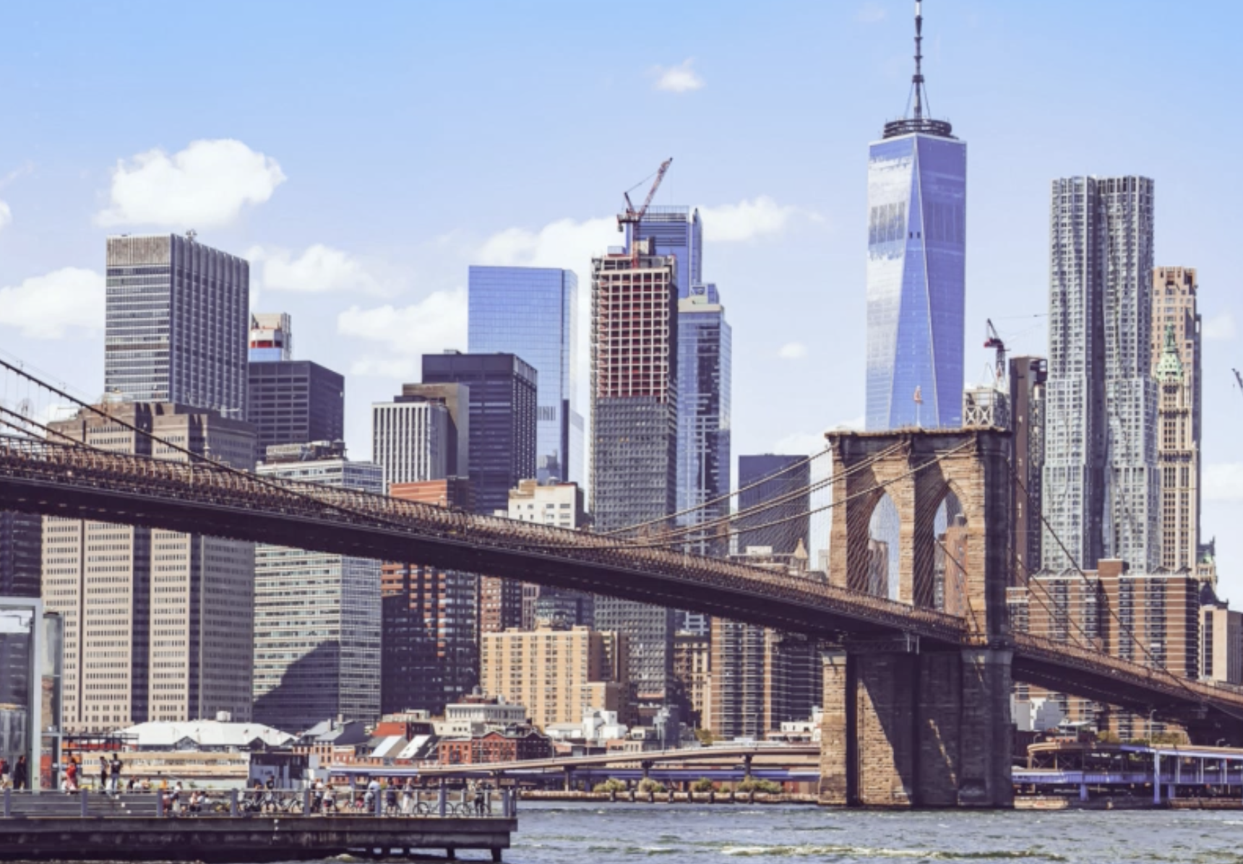
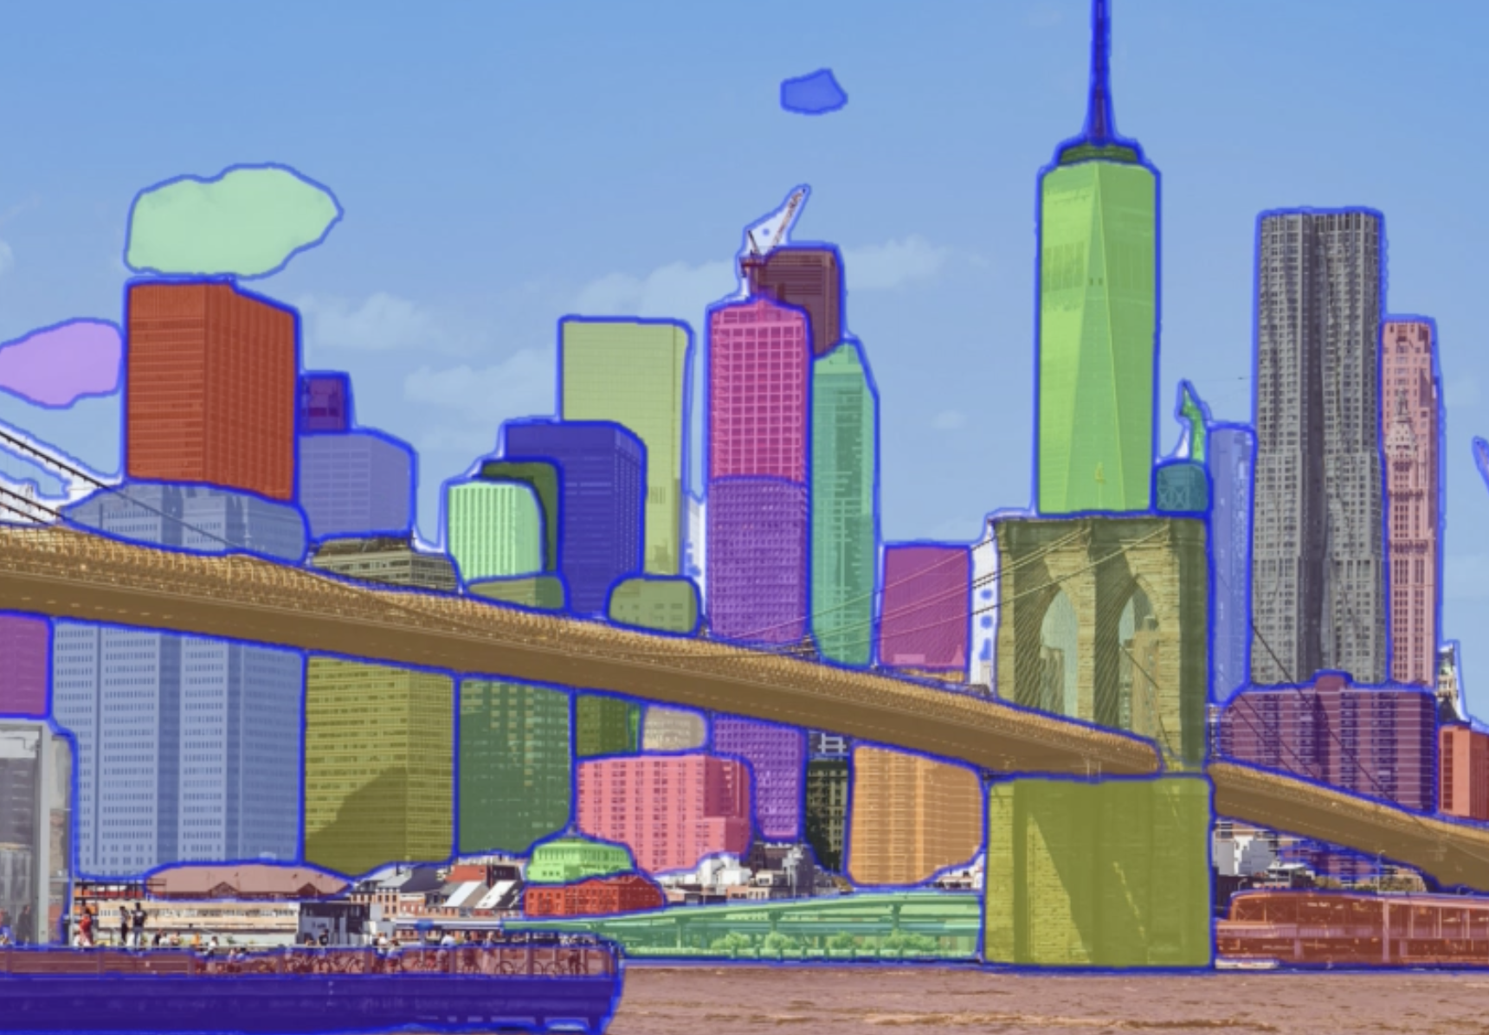
Background : The Image/Video Segmentation task
Image Segmentation: Dividing an image into meaningful regions.
Image/Video segmentation has several applications :
Medical field[Zhou+, MIA23]
Autonomous driving [Rufus+, IROS21]
Image editing [Xie+, 23]
Need for effective model

Slide 3
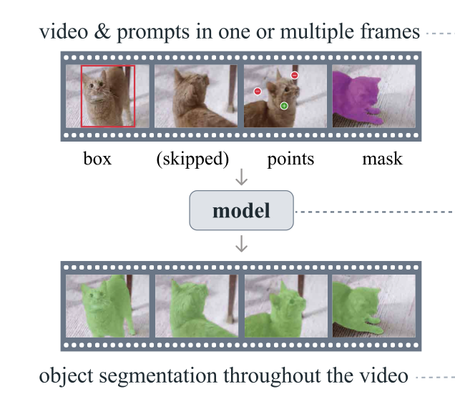
Problem Statement (1/2) :The Promptable Visual Segmentation (PSV) task
Promptable Visual Segmentation: Generalizing image segmentation to video domain.
Input (for any frame):
Points
Boxes
Masks
(Nothing) = Same as last frame
“Segment of interest”
Output:
Visual segmentation
Keep temporal consistency

Slide 4
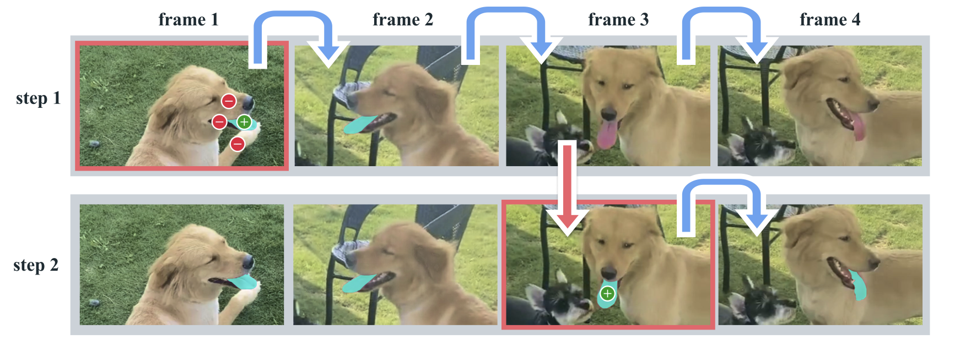
Problem Statement (2/2) :The Promptable Visual Segmentation (PSV) task in detail
Prompt is propagated
Model lost the prompt
User can correct the model by adding a prompt

Slide 5
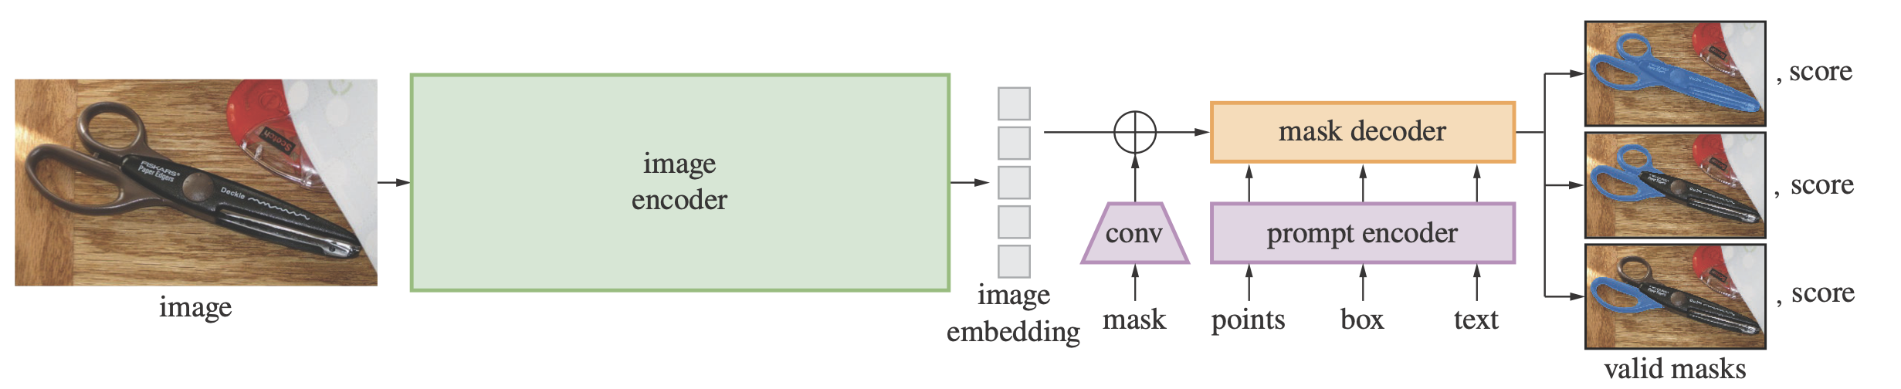
Related Works (1/2) : Image Segmentation
SAM [Kirillov+, ICCV23] | General-purpose image segmentation model that combines a promptable segmentation task with a large-scale dataset.
HQ-SAM [Ke+, NeurIPS24] | Extension of SAM that significantly enhances segmentation quality, especially for intricate object structures.
SAM [Kirillov+, ICCV23]

Slide 6
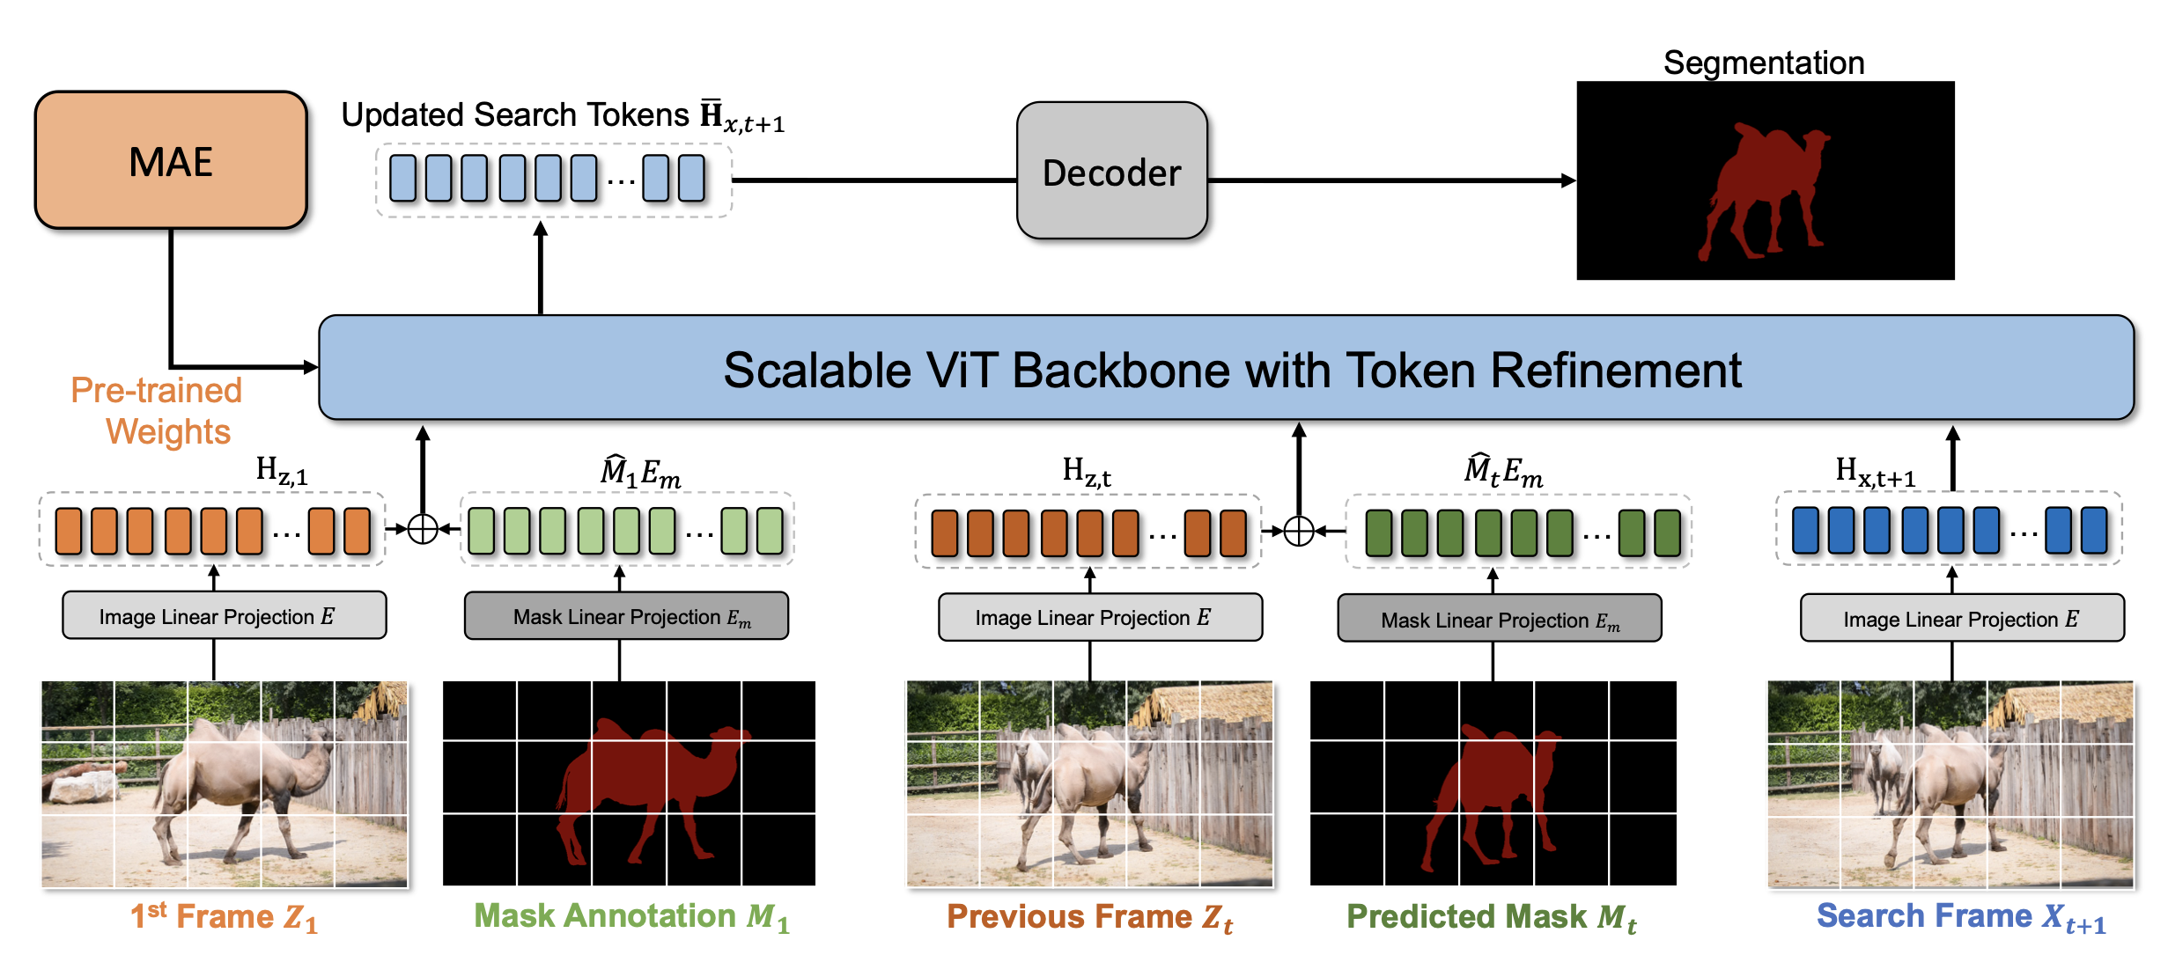
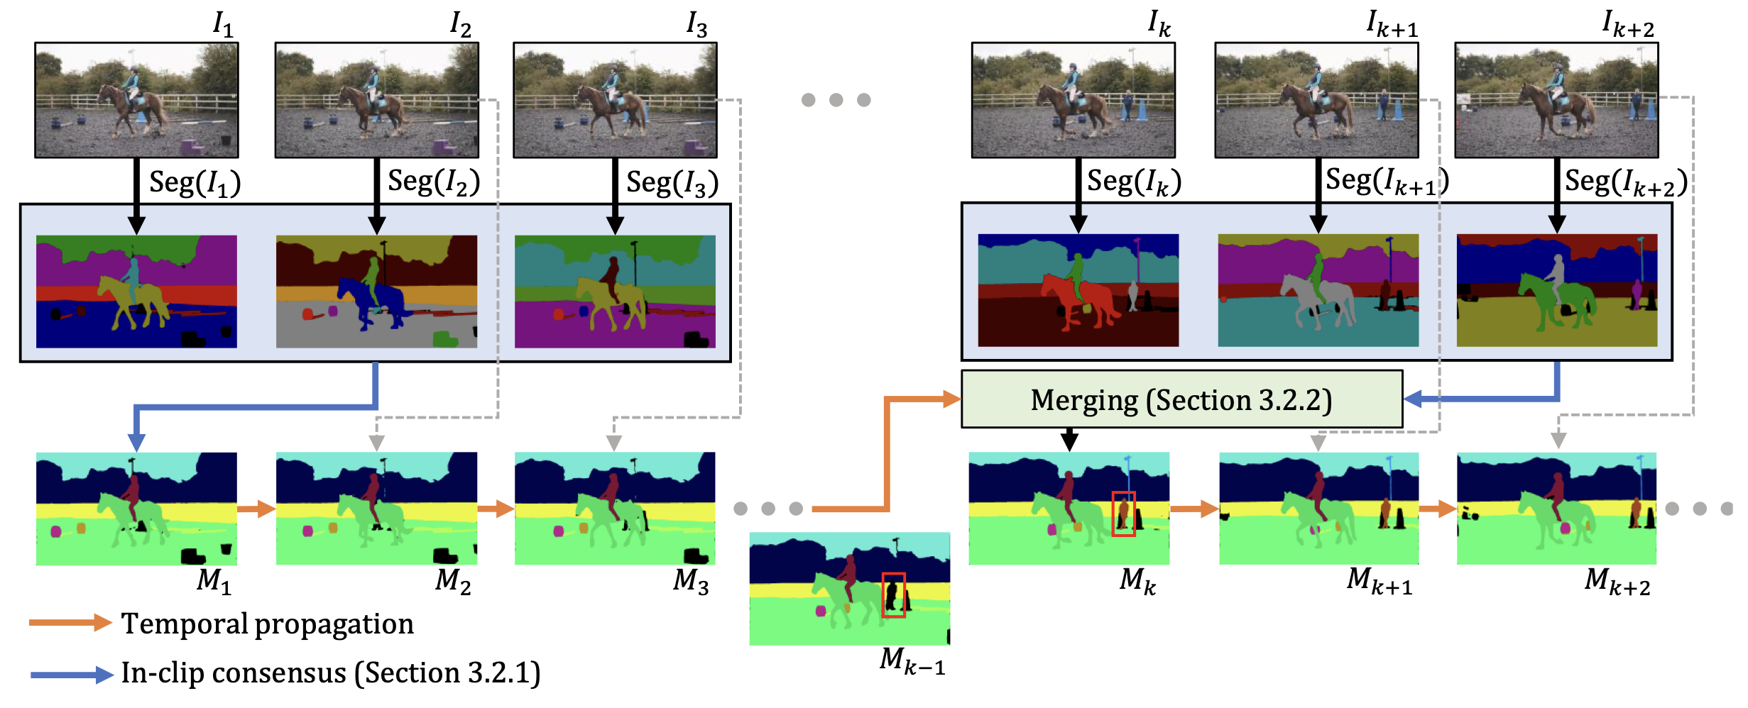
Related Works (2/2) : Video Object Segmentation (VOS)
DEVA [Cheng+, ICCV23] | Video segmentation using image segmentation with bi-directional temporal propagation.
SimVOS [Wu+, ICCV23] | Video segmentation with feature extraction and matching using a unified transformer backbone.
EVA-VOS [Delatolas+, WACV24] | Human-in-the-loop framework for video object segmentation.
DEVA [Cheng+, ICCV23]
SimVOS [Wu+, ICCV23]

Slide 7
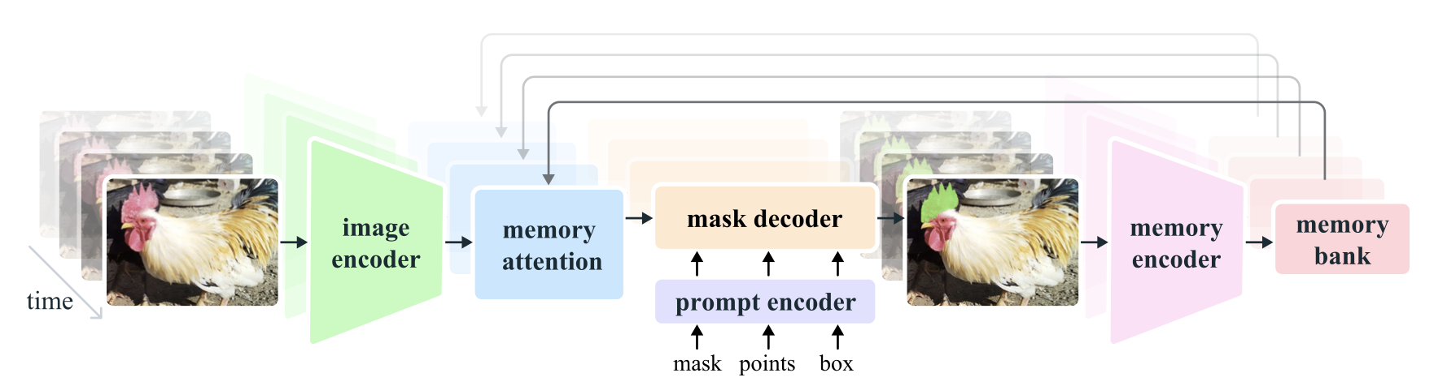
Proposed Method : The SAM 2 model architecture
SAM 2: Generalizing SAM to video domain.
Spatially similar to SAM
Conditionned by past frames
Prompts can be iteratively added

Slide 8
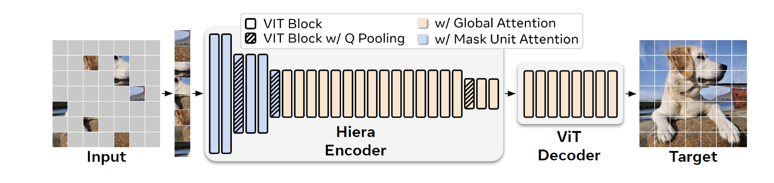
Proposed Method : The SAM 2 model architecture - Image Encoder
Cf: Hiera [Ryali+, ICML23]
Hiera image encoder only run once for the entire interaction

Slide 9
Proposed Method : The SAM 2 model architecture - Memory attention
Memory attention to condition the current frame on the past frames

Slide 10
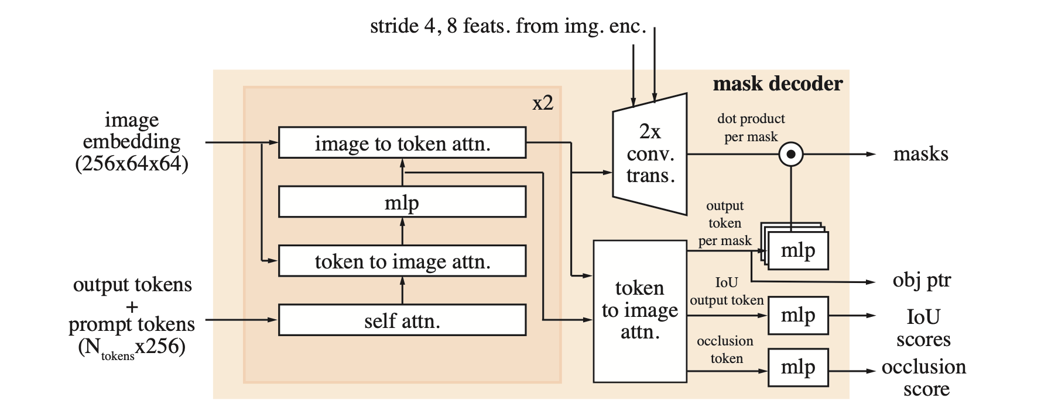
Proposed Method : The SAM 2 model architecture - Mask decoder and prompt encoder
Decoder is “two-way” transformer blocks that update prompt and frame embeddings.

Slide 11
Proposed Method : The SAM 2 model architecture - Memory encoder and memory bank
Downsampling the output mask and fuse with frame embeddings.
Retains information about past predictions for the target object (FIFO queue).

Slide 12
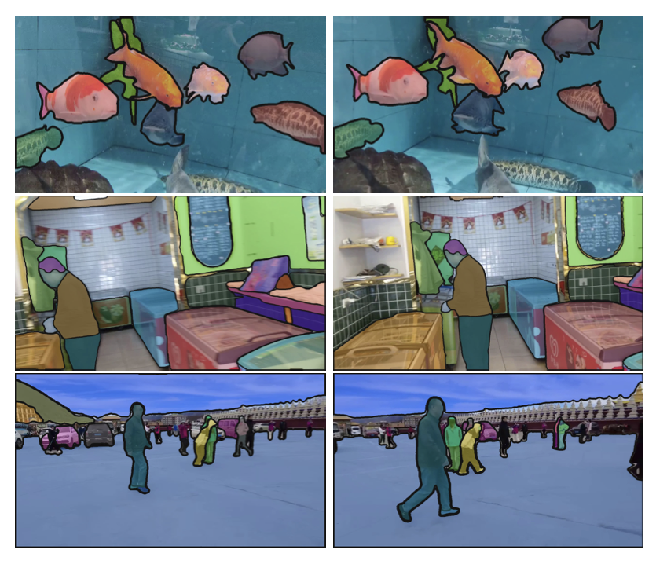
Proposed Method : The SA-V Dataset
The SA-V dataset:
50.9K videos
196 hours
642.6K masklets
4.2M frames
Resolution from 240p to 4K (1,401x1,037 on average)
Duration from 4s to 2.3min with 13.8s on average

Slide 13
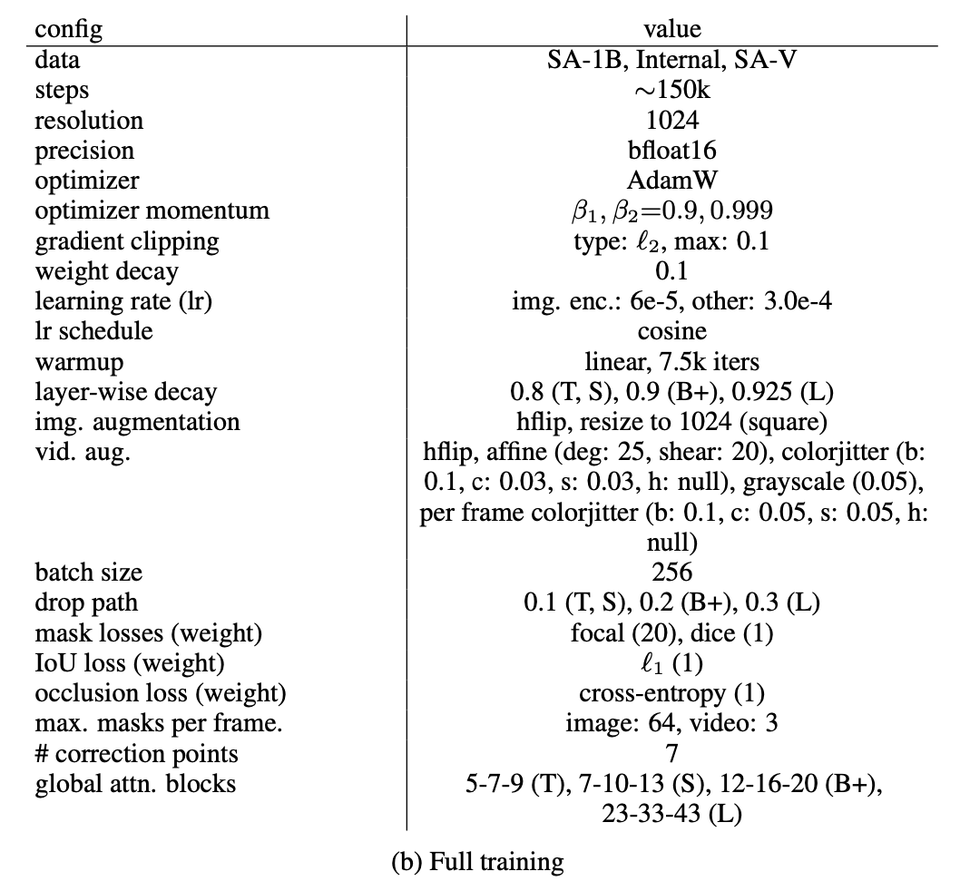
Experimental settings: Training procedure
Training:
Pretrained on SA-1-B dataset (from SAM paper)
Trained jointly on image and video data
Interactive setting
Up to 2 frames (from 8) are corrected with a click
Trained on 256 A100 for 108 hours (!!)
Inference:
Using 1 A100
130 FPS (>21.7 = SAM)

Slide 14

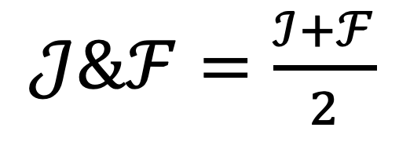
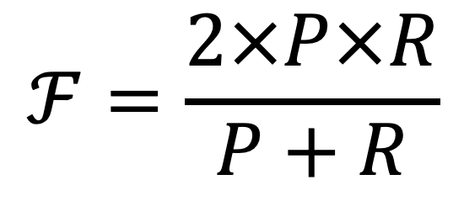
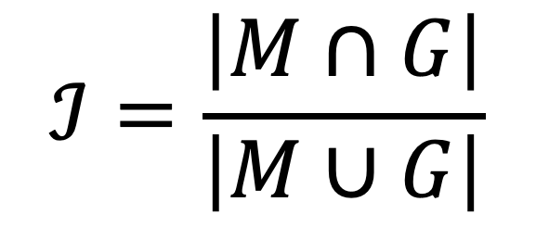
Quantitative results : The $𝓙\&𝓕$ metric
Jaccard Index = Intersection over Union (IoU)
$$ℐ=\frac{\left|M∩G\right|}{\left|M∪G\right|}$$
Region similarity between the segmented mask M and the ground truth mask G.
F-measure = F-score
$$ℱ=\frac{2×P×R}{P+R}$$
Precision and recall are calculated from the contour points of the segmented mask c(M) and the ground truth c(G).
Mean of $𝒥\&ℱ$
$𝒥\&ℱ=\frac{ℐ+ℱ}{2}$
Aggregates the performance captured by both the Jaccard Index and F-measure.

Slide 15
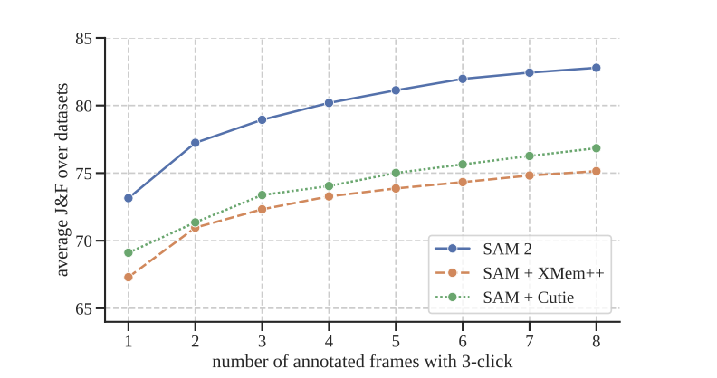
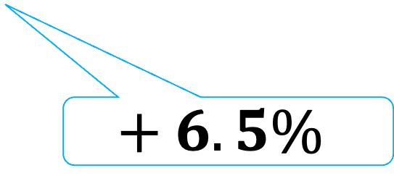
Quantitative results : On the PVS task, SAM 2 outperformed the baselines
$$+ 6.5\%$$
X-axis: First frame is initialized with 3 clicks that are propagated across the video.
When a frame IoU < 0.75 with ground-truth, this frame is prompted with correct clicks.
This is repeated while the number of prompted frames is less than the maximum N (= value on x-axis).

Slide 16
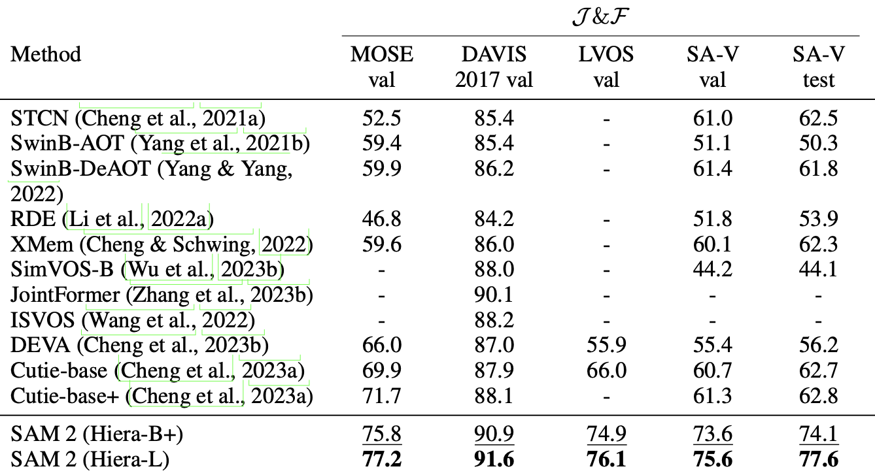
Quantitative results (2/2) : On the Image Segmentation task, SAM 2 outperformed the baselines

Slide 17
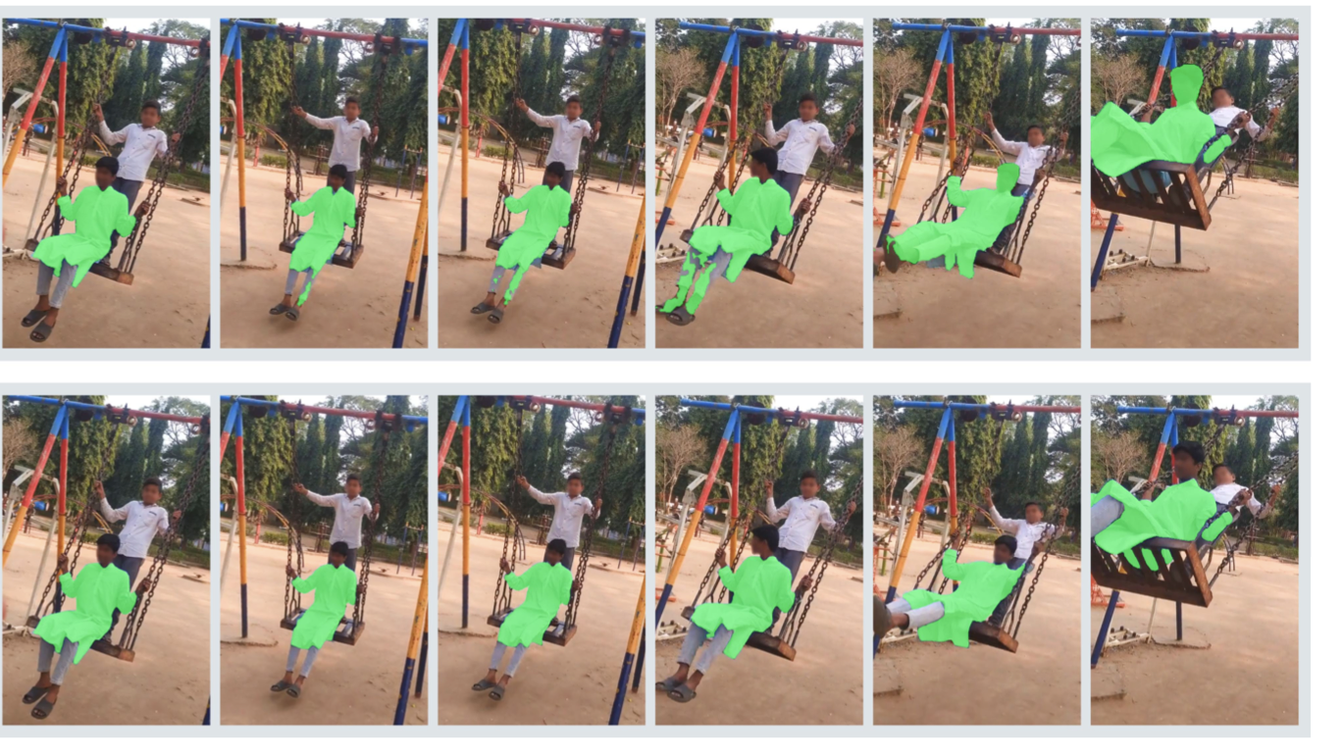
Qualitative results : SAM 2 correctly shows consistency across the frames
SAM+Cutie
SAM 2

Slide 18
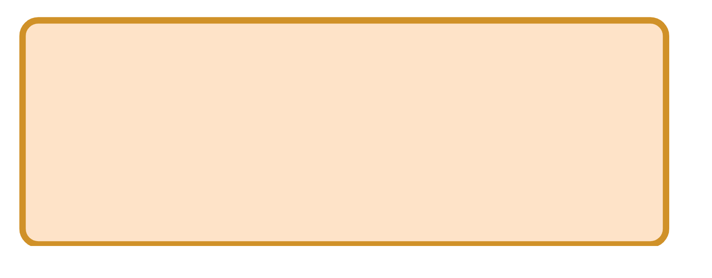
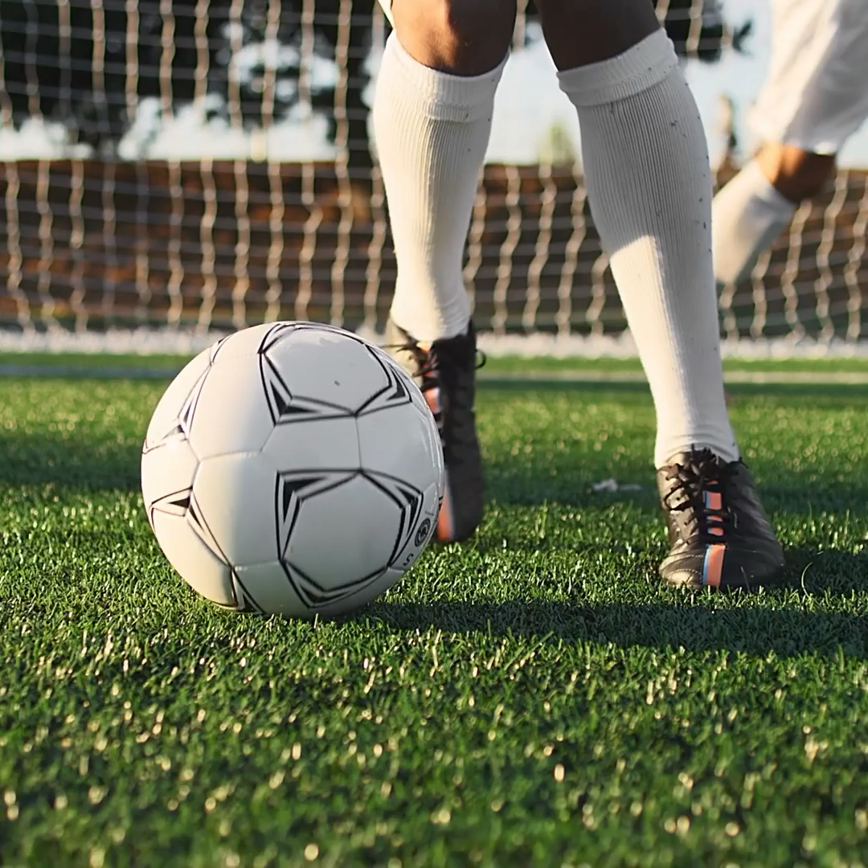
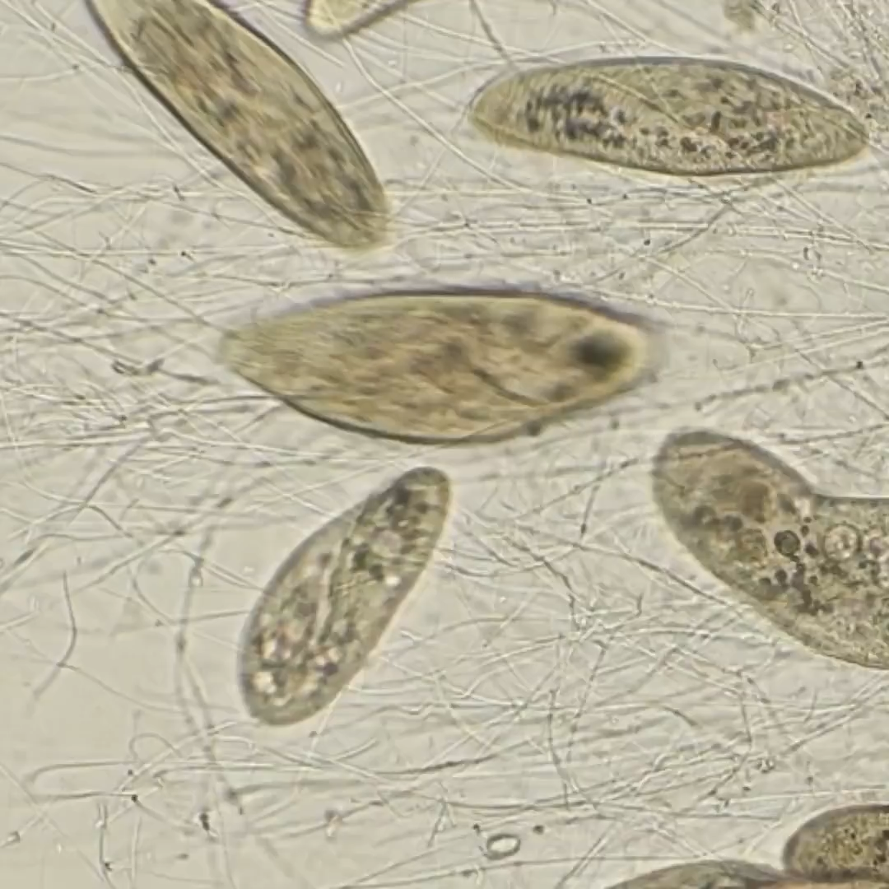
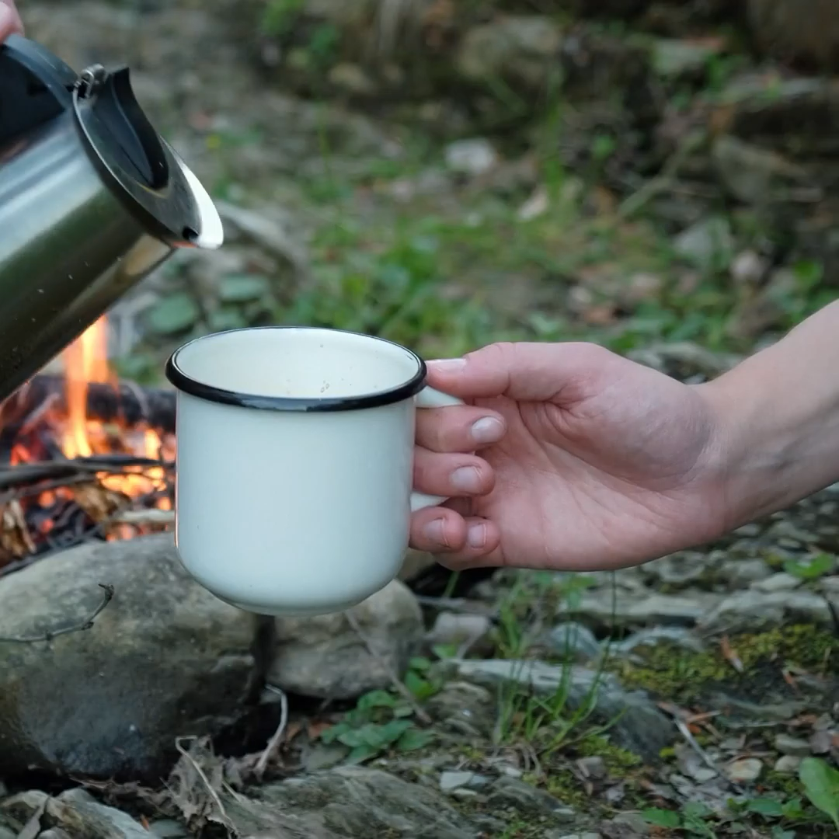
Qualitative results : SAM2 performs strongly across a variety of usages
Adjustments across video frames
Robust Segmentation
Real-time interactivity

Slide 19
Conclusion : A foundation model for Image and Video Segmentation
SAM 2: Segment Anything in Images and Videos
State-of-the-art for BOTH image and video.
Perform better than SAM with a smaller computationnal cost.
SA-V: A large dataset for Video Segmentation.
Limitations :
Cannot recognize segmented objects
Note:
Under review for ICLR25
10, 8, 8, 10

Slide 20
My thoughts : A model that solves the segmentation task for both image and video
Strength:
Very strong results and detailled experiments.
A large dataset is released to help the community.
Faster than SAM.
Weakness :
Could have explained more about the motivations behind the architecture choices.
Opinion:
Can be used as a backbone model for many tasks.
Ex : EVF-SAM [Zhang+, 24]

Slide 21
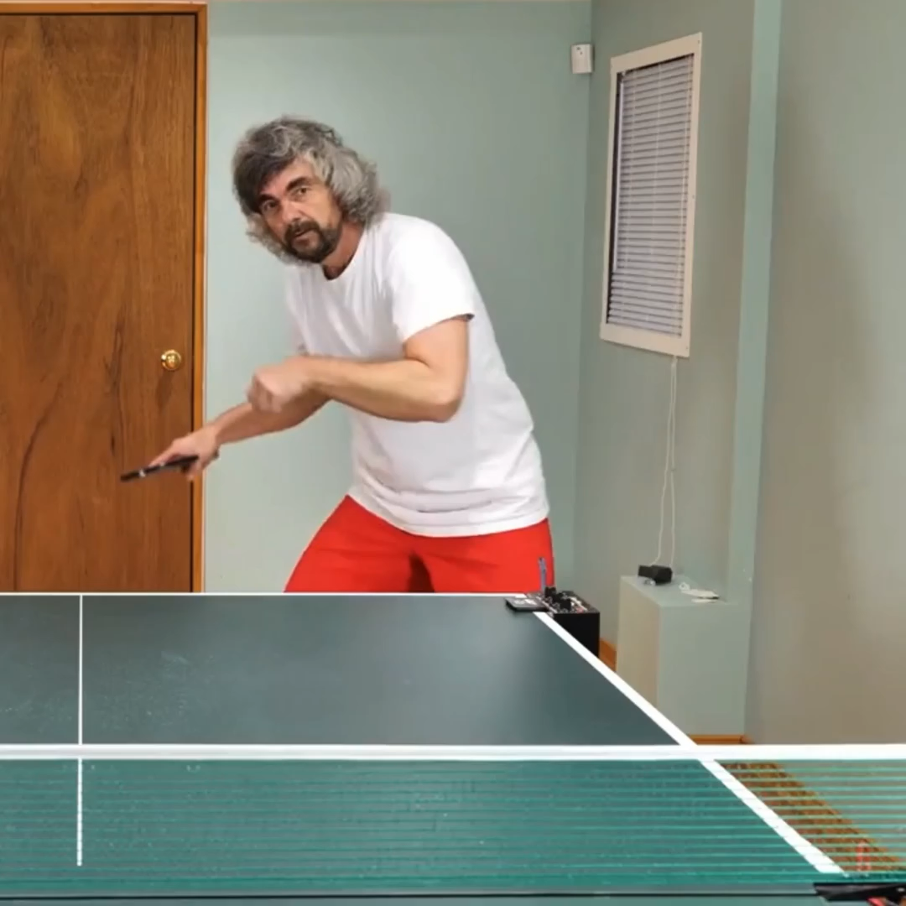

Summary – SAM 2: Segment Anything in Images and Videos

